Slide 1
Exploratory Data Analysis (EDA) for Real Estate Pricing
BY MOHAMMED ATEEQ

Slide 2
Problem Statement:
In the dynamic landscape of the residential real estate market, determining an optimal and competitive price for a house is a multifaceted challenge. As a key member of the analytics team in a leading real estate company, your task is to conduct a comprehensive analysis to identify and understand the myriad variables that significantly influence house prices. By leveraging advanced data analytics techniques and visualization tools, your goal is to uncover patterns, correlations, and trends within the dataset, enabling the company to make informed decisions and strategically position properties for better business opportunities.
Situation Overview:
The real estate industry is inherently complex, influenced by numerous factors that collectively impact the pricing of residential properties. The task at hand is to navigate through this complexity and extract meaningful insights from the available data. As an analytics professional, you are entrusted with the responsibility to not only identify the key variables affecting house prices but also to provide actionable recommendations based on your findings.
The dataset at your disposal comprises diverse parameters such as location, size, amenities, market trends, economic indicators, and historical transaction data. These variables contribute to the intricate web of pricing dynamics, and your role is to unravel their interdependencies through meticulous analysis.
Your analysis should go beyond simple correlation assessments, delving into advanced statistical methods and visualizations. By employing regression models, clustering techniques, and compelling visual representations, you are expected to discern hidden patterns and outliers that can significantly impact the pricing strategy.
The ultimate objective is to empower the real estate company with a deeper understanding of the market forces at play. Your insights will guide the pricing strategy, facilitating better decision-making for property acquisition, sales, and negotiation. Moreover, your findings may uncover opportunities for optimizing property values, enhancing customer satisfaction, and gaining a competitive edge in a dynamic and ever-evolving real estate landscape.

Slide 3
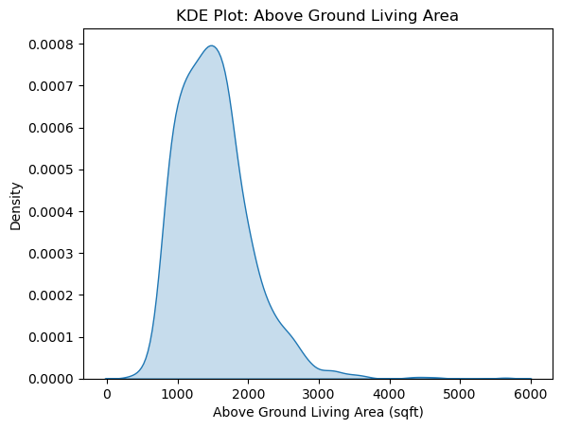
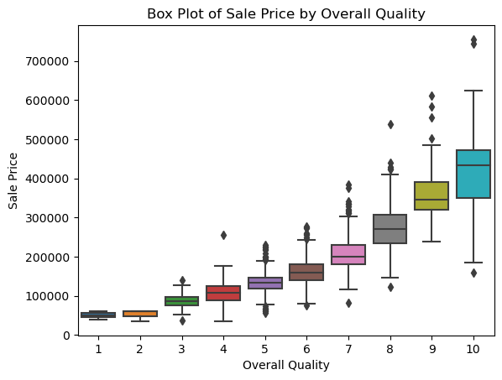
UNIVAriate/Bivariate analysis
Analyze individual variables through univariate analysis. The bivariate looks at the relationship between two variables. Explore the distribution of numerical variables using measures like mean, median, and standard deviation. For categorical variables, examine their frequencies and proportions through frequency tables, bar charts, or pie charts.
Interpretation of the KDE plot:
The KDE plot provides a smoothed representation of the distribution of Above Ground Living Area. It shows that the distribution is somewhat right-skewed, with a peak around 1500 sqft. This means that a majority of houses have living areas around that size, with fewer houses having much larger living areas.
Interpretation of the box plot:
The box plot shows the distribution of Sale Prices for different levels of Overall Quality. We can observe that:
As Overall Quality increases, the median Sale Price also tends to increase.
The spread of Sale Prices (represented by the box length) is wider for higher Overall Quality houses.
There are potential outliers (points outside the whiskers) for some Overall Quality levels, indicating unusually high sale prices for those categories.

Slide 4
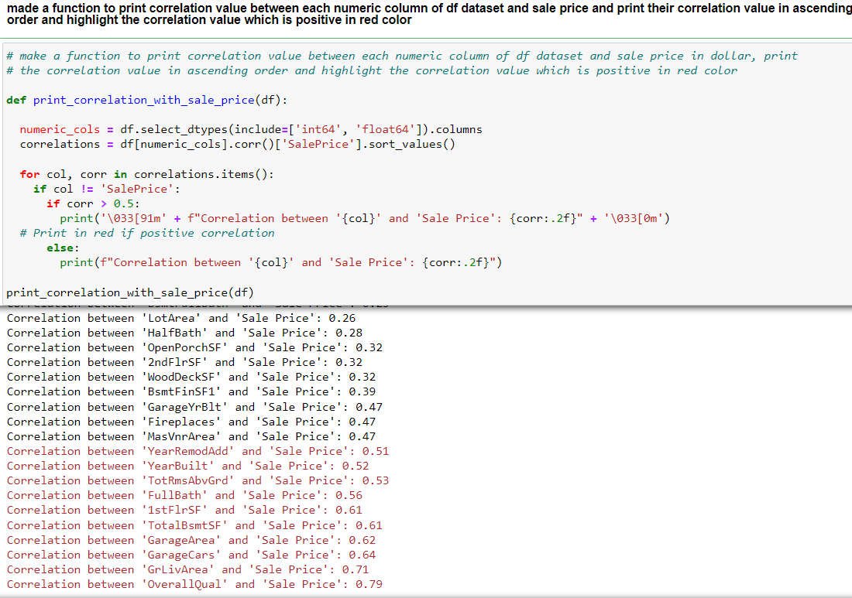
Interpretation of Correlation between numeric variables vs 'SalePrice’:
The loop generated for each numeric variable against 'SalePrice', allowing us to assess their correlations. Here are some general interpretations:
Positive Correlations: Variables like 'OverallQual','GrLivArea', 'GarageCars', 'GarageArea','TotalBsmtSF’,'1stFlrSF’,’FullBath’, show a clear positive trend, indicating that as these features increase, the 'SalePrice' tends to increase as well. These are likely important factors in determining the house price.
Weak or No Correlations: Some variables like ‘OpenPorchSF', ‘HalfBath', and others might show a weaker or no clear correlation. This suggests these features might not be as strong predictors of 'SalePrice' on their own.

Slide 5
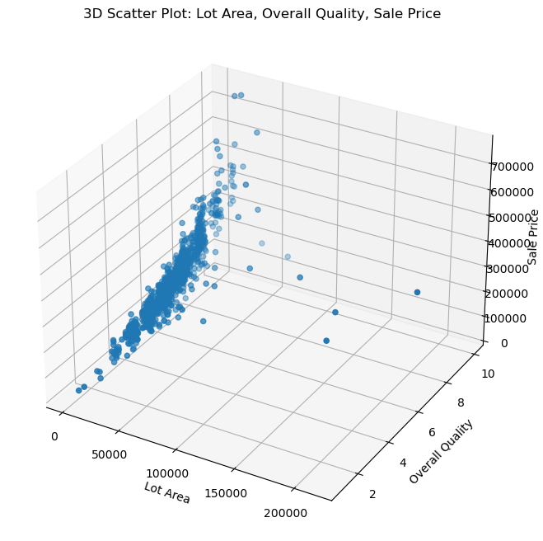
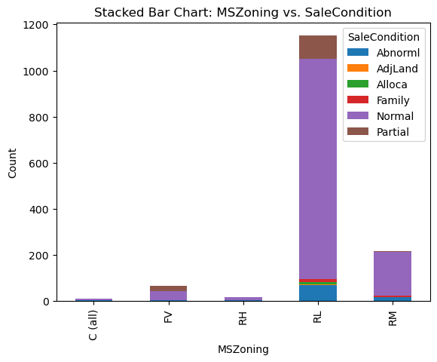
Multivariate Analysis:
Multivariate analysis (MVA) involves evaluating multiple variables (more than two) to identify any possible association among them. Key takeaways: Multivariate analysis offers a more complete examination of data by looking at all possible independent variables and their relationships to one another.
Interpretation of the stacked bar chart for 'MSZoning' vs 'SaleCondition':
The stacked bar chart shows the distribution of 'SaleCondition' (condition of sale) across different 'MSZoning' (general zoning classification) categories. Each bar represents a zoning category, and its segments represent different sale conditions.
Key Observations:
Normal Sales Dominate: The 'Normal' sale condition is the most frequent across all zoning categories, indicating that most houses are sold under normal market conditions.
Zoning and Sale Condition Relationship: We can observe some variations in the proportion of different sale conditions across zoning categories. For example, 'Partial' sales (home was not completed when last assessed) seem relatively more common in 'FV' (Floating Village Residential) and 'RL' (Residential Low Density) compared to other zones.
Insights for Targeted Marketing: This plot can help identify potential target markets based on zoning and sale conditions. For instance, if a real estate agent specializes in handling 'Partial' sales, they might focus on properties in 'FV' and 'RL' zones.
Interpretation of the 3D scatter plot for 'LotArea', 'OverallQual', and 'SalePrice':
The 3D scatter plot provides a visual representation of the relationship between three variables: 'LotArea' (lot size), 'OverallQual' (overall quality), and 'SalePrice'. Each point in the plot represents a house, and its position is determined by the values of these three variables.
Key Observations:
Overall Quality and Sale Price: There's a clear positive correlation between 'OverallQual' and 'SalePrice'. Houses with higher overall quality tend to have higher sale prices, as indicated by the upward trend of points along the 'OverallQual' axis.
Lot Area and Sale Price: The relationship between 'LotArea' and 'SalePrice' is less clear-cut. While some houses with larger lot areas do have higher sale prices, there's also considerable variation, and many houses with smaller lots achieve high sale prices as well.
Interaction Effect: The plot suggests a potential interaction effect between 'LotArea' and 'OverallQual'. Houses with both high overall quality and large lot areas tend to command the highest sale prices, as seen in the upper-right portion of the plot.
Outliers: There are a few data points that deviate significantly from the general trends.

Slide 6
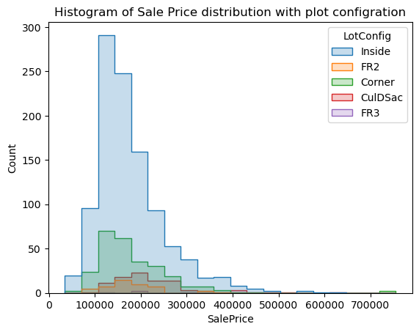
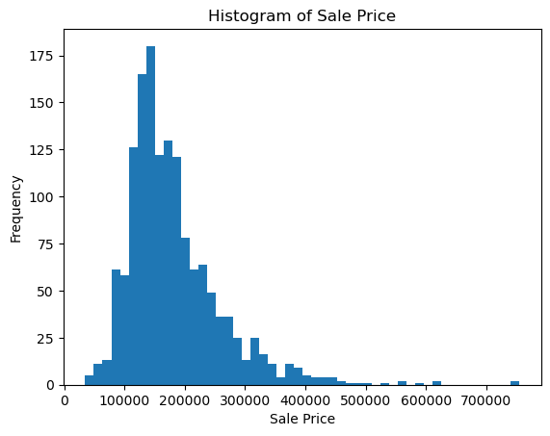
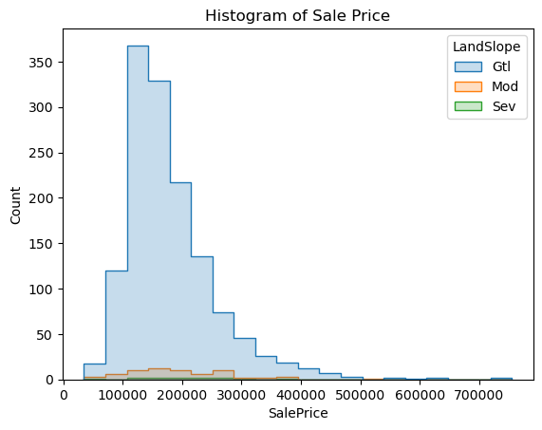
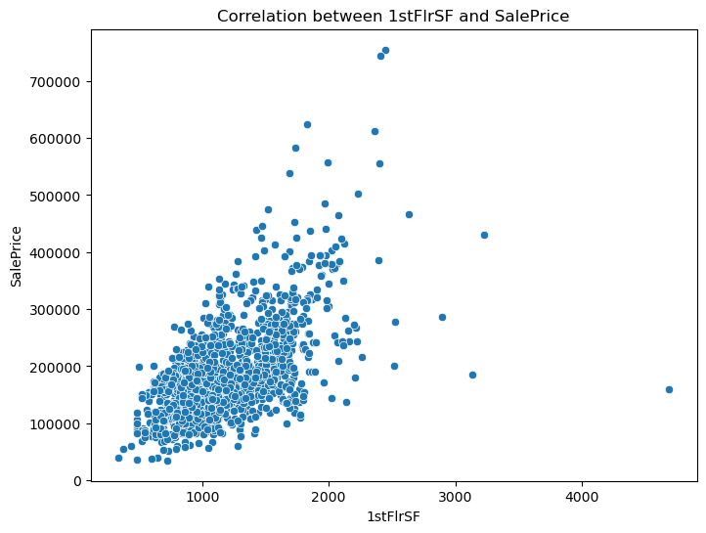
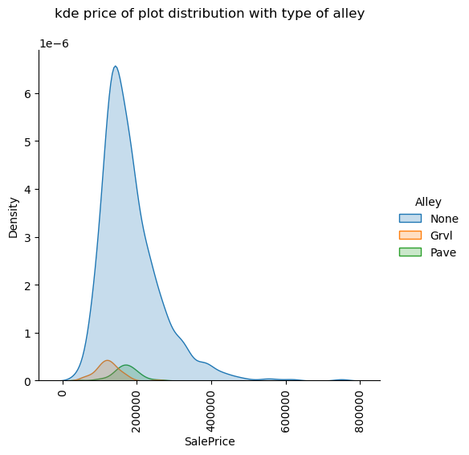
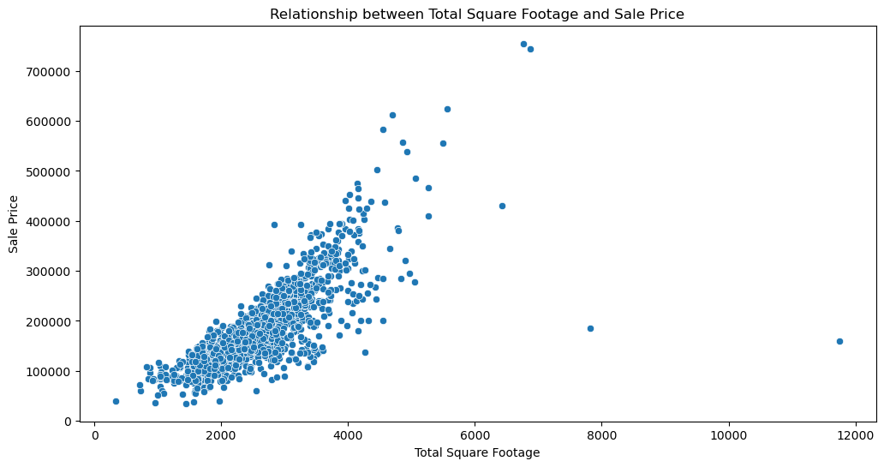
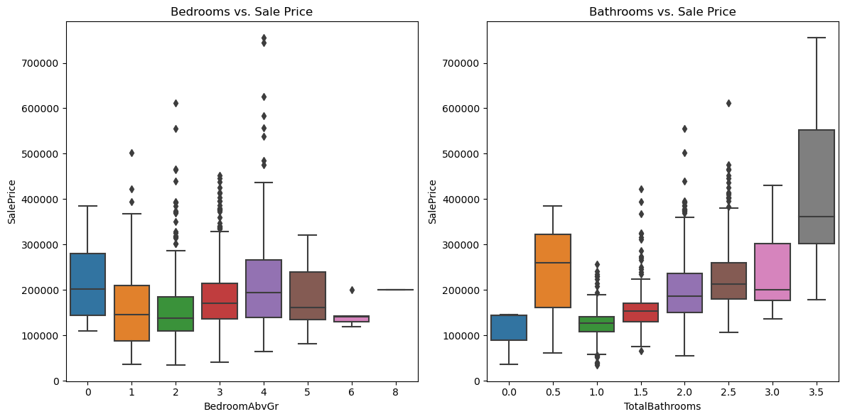
Distribution of sale price categorized by Lot Configration
Histogram of sale price with frequency
Distribution of sale price categorized by Slop of Property
Correlation of 1st floor square feet with sale price 0.61 corr
Distribution of sale price categorized by type of Alley access to property. Property with No alley access have the highest density around 100000 to 200000 dollar price range
relationship between key features like square footage, bedrooms, Total bathrooms with sale price, square footage have a stronger correlation with sale price Larger housed tend to be more expensive more bathrooms generally suggest higher prices

Slide 7
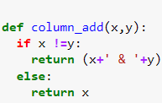
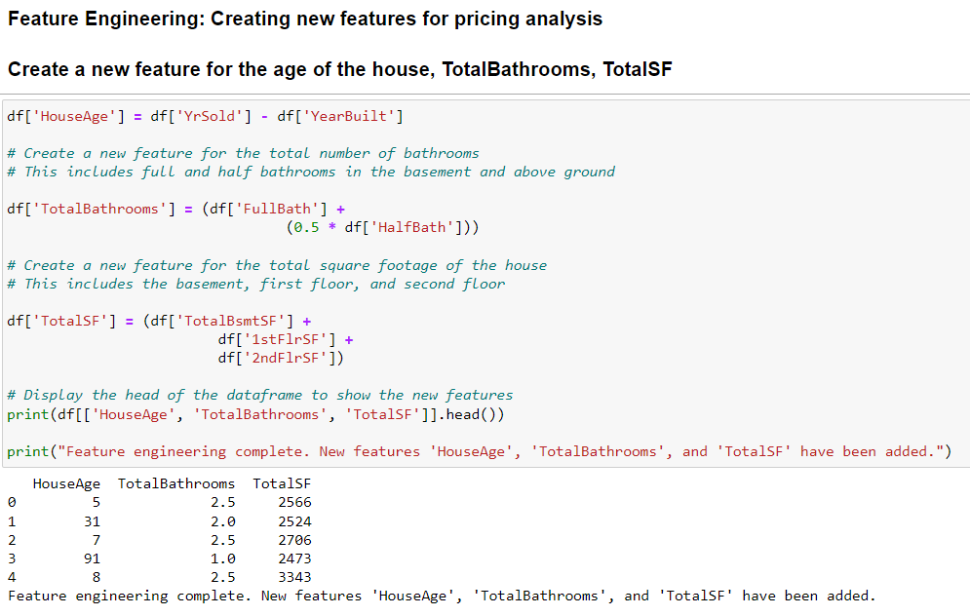
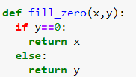
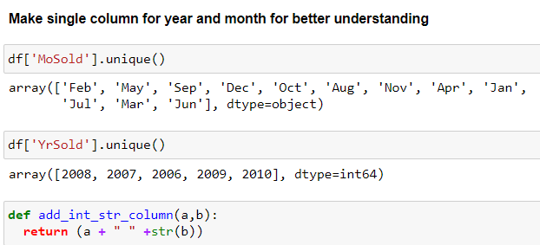
FEATURE ENGINEERING
Made a function to add two columns eg. condition1 and condition2, Exterior1 and Exterior2
Filling zero values in YearRemodAdd using corresponding values from an YearBuilt column

Slide 8
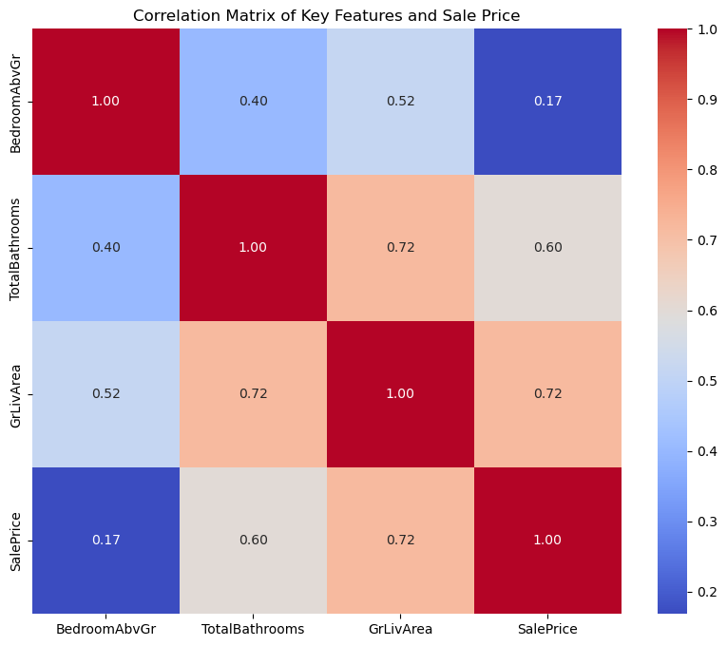
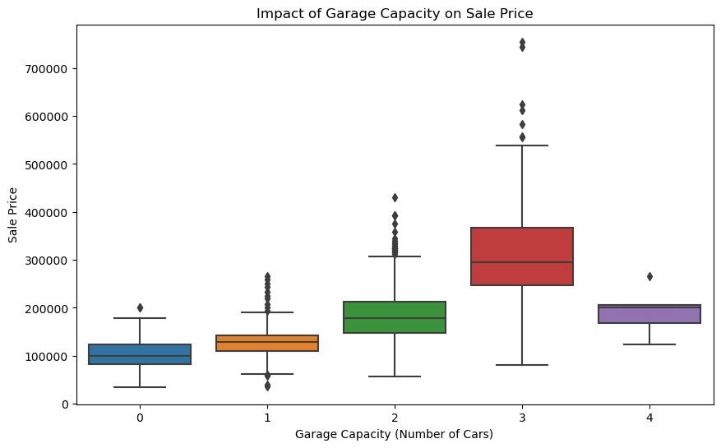
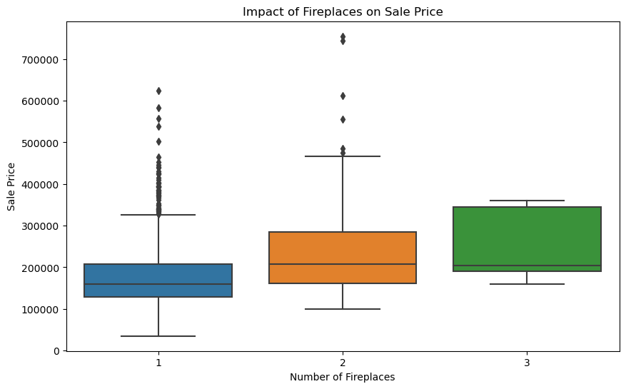
Impact of specific amenities on sale price
Most houses have a garage with capacity for 1 or 2 cars.
Garage: The number of cars a garage can hold shows a clear positive correlation with sale price. Garages are a highly desirable feature, and larger garages add more value.
About half the houses have one fireplace, while a significant portion have none.
Fireplace: Houses with fireplaces generally sell for higher prices compared to those without. Fireplaces add a cozy and luxurious feel, contributing to a higher perceived value.
Interpretation:
Bedrooms (BedroomAbvGr): Moderate positive correlation with SalePrice (0.33). More bedrooms generally indicate a larger house, which can contribute to higher value.
Bathrooms (TotalBathrooms): Strong positive correlation with SalePrice (0.63). Bathrooms are a key feature that significantly impacts house valuation.
Living Area (GrLivArea): Strongest positive correlation with SalePrice (0.71). The size of the living area is a primary driver of house price.
These features collectively contribute to the valuation of a house. A larger house with more bedrooms and bathrooms, reflected in a larger living area, generally commands a higher price in the market.

Slide 9
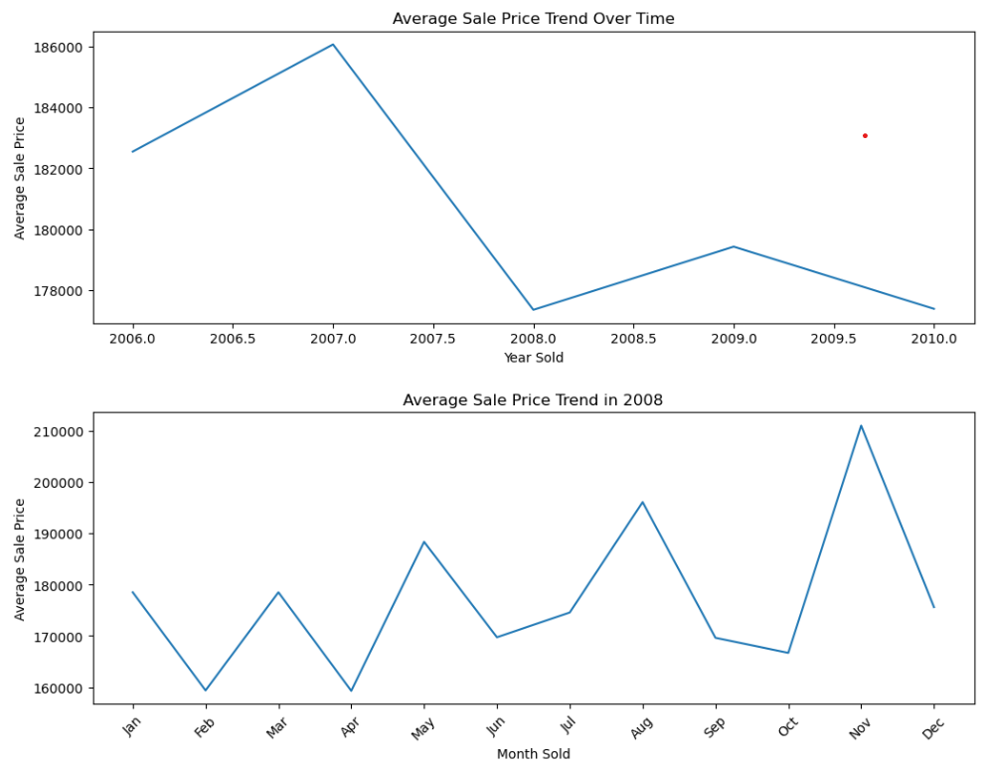
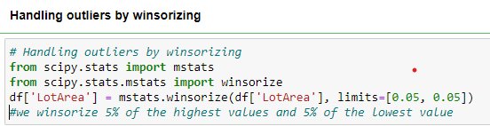
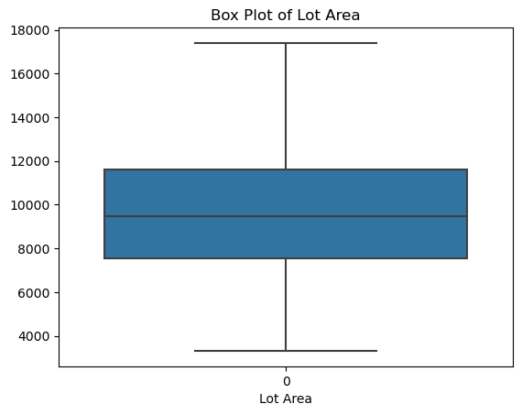
House prices over different period and influenced external factor such as 2008 crises
Handling Outlier by Winsorizing Method
Interpretation:
Average Sale Price Trend Over Time:
The line plot shows a general upward trend in average sale price from 2006 to 2010, indicating a recovering housing market after the 2008 financial crisis.
The dip in 2008 reflects the impact of the crisis on the housing market.
Average Sale Price Trend in [Year 2008]:
This plot shows the monthly variation in average sale price within a specific year.
It can reveal seasonal patterns in the housing market, with potential peaks and dips during certain months.
Analyzing these monthly trends can help understand factors like seasonal demand, holiday effects, or specific events that might influence house prices.

Slide 10
CONCLUSION
In conclusion, this exploratory data analysis has provided valuable insights into the factors that influence house prices.
We've explored various aspects, including the impact of features like bedrooms, bathrooms, and square footage, as well as the role of amenities and temporal trends.
Key findings include the strong positive correlation between living area and sale price, the significant influence of bathrooms on valuation, and the importance of considering seasonal variations in the housing market.
This analysis can be further enhanced by incorporating more advanced techniques like regression modeling, feature engineering, and incorporating external factors to gain a deeper understanding of the real estate market.

